Slide 1
IoT Air Monitoring and Reporting System for Residential Environments
Farah Shaheen

Slide 2
01
02
03
INTRODUCTION
Literature Review
System Architecture
04
05
06
Implementation
Testing
Time Series Forecasting
What is IAQ, IAP and purpose of research
Existing IoT IAQ Systems
Methodology

Slide 3
01
Introduction
Background Information about the topic

Slide 4
Indoor Air Pollution?

Slide 5
Indoor Air Quality
Impact in residential environments
Source of Indoor Air Pollution
Health Risks Associated with Indoor Air Pollution
homes, hospitals, office spaces
90% of rural households use unprocessed biomass
Improper heating and cooling system ventilation
High levels of exposure can cause:
chronic obstructive pulmonary disease
lung cancer
acute respiratory infections
severe eye diseases
People spend approximately 80-90% of their time indoors
Notes:
Talk about processed biomass: biomass converted to solid, liquid or gaseous fields that can be used to produce heat. Electricity, and transport fuel
Unprocessed biomass is wood, wood residues, crop residues, waste from industry, household
incomplete combustion of carbon-containing fuels
The most common biomass materials used for energy are plants, wood, and waste

Slide 6
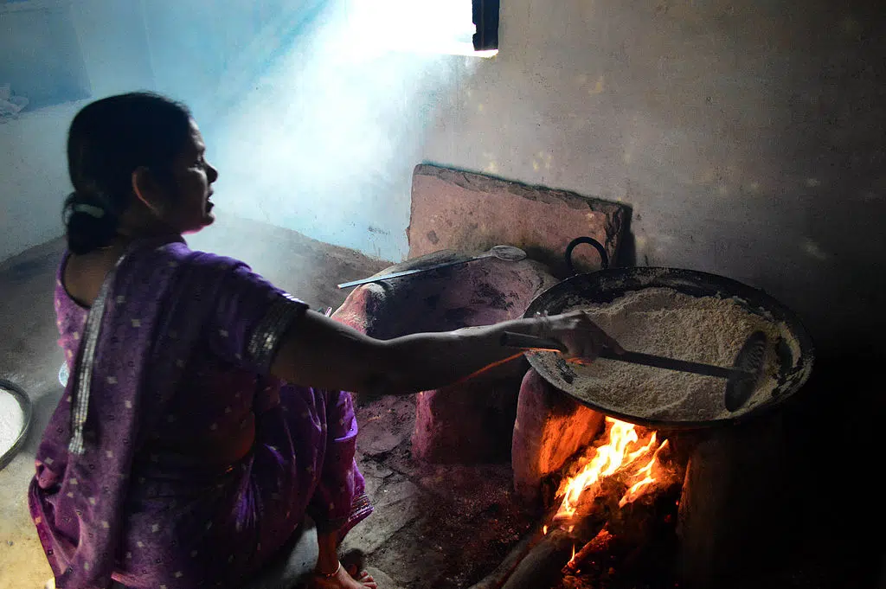
"Image source: Earth.Org article 'What Is Indoor Air Pollution?
Notes:
Black carbon (also known as soot) and methane – a greenhouse gas that is more potent is carbon dioxide – emitted by inefficient combustion in households are powerful pollutants contributing to climate change. Household cooking and heating appliances account for the highest source of black carbon which basically involve the use of coal briquettes, wooden stoves and traditional cooking appliances.

Slide 7
Indoor Air Quality
First world-countries
Sick Building Syndrome (SBS)
Health Risks Associated with Indoor Air Pollution
Buildings are airtight and rely HVAC systems
People spend approximately 80-90% of their time indoors
Happens when people in a building start feeling unwell but their symptoms often disappear when leaving the affected building
High levels of exposure can cause:
chronic obstructive pulmonary disease
lung cancer
acute respiratory infections
severe eye diseases
Notes:
Talk about processed biomass: biomass converted to solid, liquid or gaseous fields that can be used to produce heat. Electricity, and transport fuel
Unprocessed biomass is wood, wood residues, crop residues, waste from industry, household
incomplete combustion of carbon-containing fuels

Slide 8
Sick Building Syndrome (SBS)
Symptoms
Headaches
Dizziness
nausea,
eye, nose or throat irritation
Causing low productivity and tiredness
Symptoms disappear as soon as leaving the polluted building
The need for indoor air quality monitoring
[13]

Slide 9
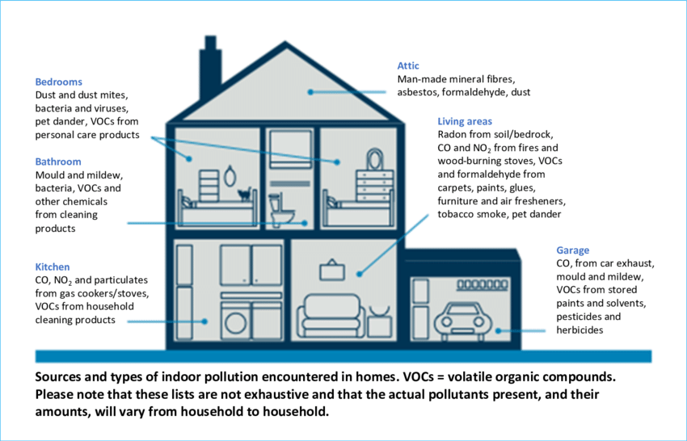
[15, Fig 5]

Slide 10
Global Statistics and Challenges
Despite improvements in cooking methods, 1.3 billion in Asia expected to use biomass by 2030 according to the World Energy Outlook
First world countries affected by using HVAC systems without proper ventilation.

Slide 11
Sources of Indoor Air Pollutants
Pollutants | Emissions | Health Effects
CO | Stoves, kerosene, unvented kerosene, water heaters, boilers, incomplete combustion of carbon-containing fuels | Increase in perinatal death,
CO2 | Burning butane, fumes from stovetop or oven, burning of oil, coal and gas | Headaches, sleepiness, poor concentration
Asbestos | Fire retardant materials, insulation | Cancer, pleural thickening,
NO2 | Fuel burning | Asthma, wheezing, reduced lung function in children, infections in respiratory organs
Lead | Paint, soil, firearms | Memory loss, hearing loss, high blood pressure, kidney and heart disease
VOCs | Gas burning, cleaning products, hair spray, perfumes, tobacco smoke | Allergic reactions, memory impairments, damage to the central nervous system, kidney and liver failure.
Health effects and pollutants found from the following research paper : “A comprehensive review on indoor air quality monitoring systems for enhanced public health”[6]

Slide 12
Internet of Things (IoT) as a Solution
IoT-based low-cost sensors for monitoring air pollutants.
Cloud integration for real-time monitoring using Arduino Cloud.
Utilization of predictive analytics for forecasting indoor air quality (IAQ) concerns.

Slide 13
02
Literature Review
Overview of existing IAQ monitoring systems

Slide 14
Paper # 1: Internet of Things Mobile - Air Pollution Monitoring System (IoT-Mobair)

Slide 15
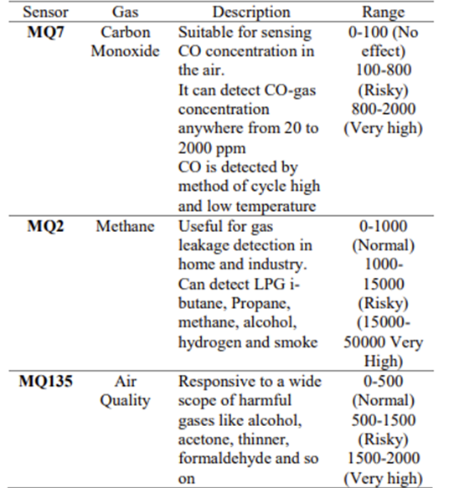
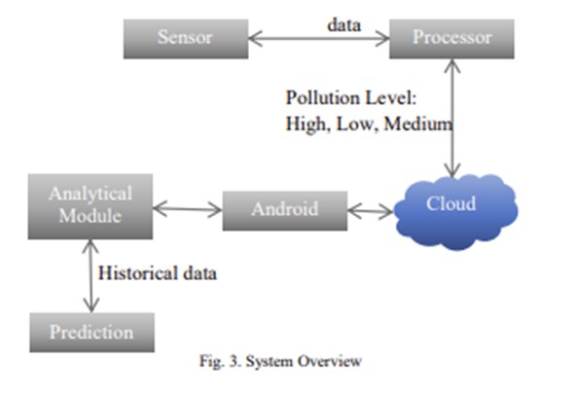
Sensors Used
System Overview

Slide 17
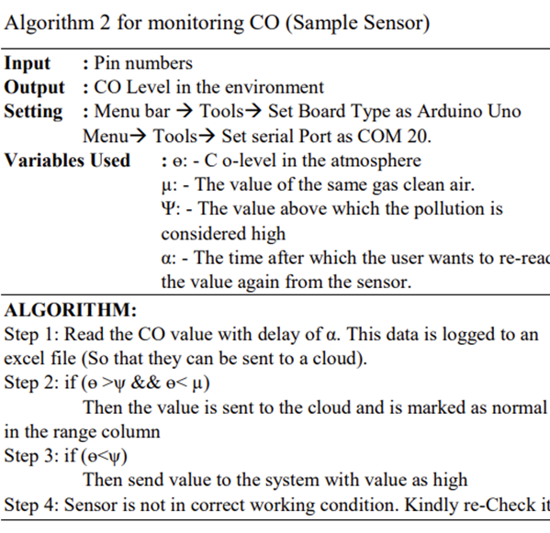
To ensure the sensors are working as expected the authors created an algorithm for a CO sensor in the Arduino sketch
Internet of Things Mobile - Air Pollution Monitoring System (IoT-Mobair) [3]

Slide 18
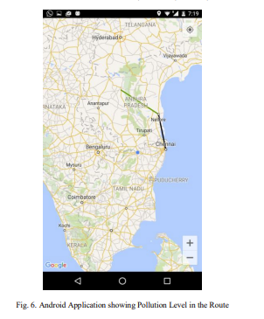
Long Short-Term Memory Model (LSTM)
Features of the Android Application called IoT-MobAir:
Real-time computation of air quality indices
Recommendations for timing outdoor activities
Health risk alerts
Application integrated with Google Maps to display the pollution level on the map.
[1, Fig.6]

Slide 19
Paper #2 Building IoT-Assisted Indoor Air Quality Pollution Monitoring System

Slide 20
Building IoT-Assisted Indoor Air Quality Pollution Monitoring System
System utilizes Raspberry Pi and ZPHS01B multi-channel sensor.
Emphasizes increased indoor air pollution risks post-COVID-19.
Lack of details on energy efficiency and power requirements.

Slide 21
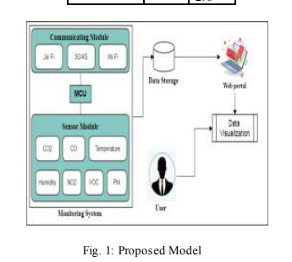
[4, Fig 1]

Slide 22
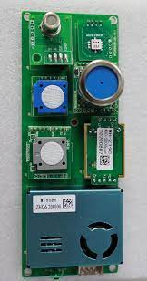
ZPHS01B multi-channel gas sensor
Developed by Winsen Electronics
Single module that has the following sensors
Laser dust sensor for measuring the concentration of particulate matter
Infrared CO2 Sensor for measuring the concentration of CO2
Electrochemical Formaldehyde sensor to measure formaldehyde
Electrochemical Ozone Sensor to measure presence of O3
Electrochemical Carbon Monoxide Sensor
VOC sensor
NO2 sensors
https://www.winsen-sensor.com/product/zphs01b.html

Slide 23
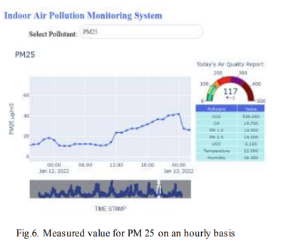
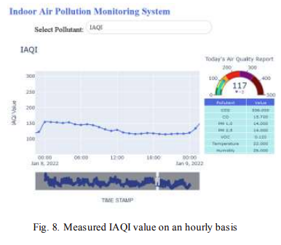
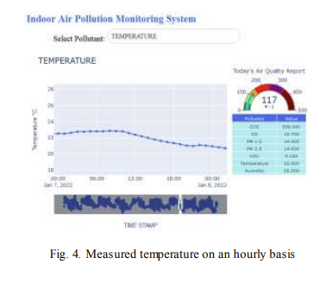
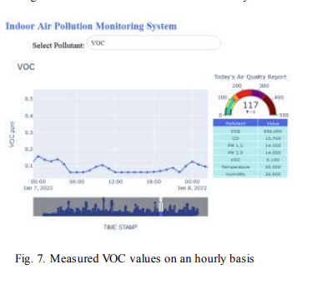
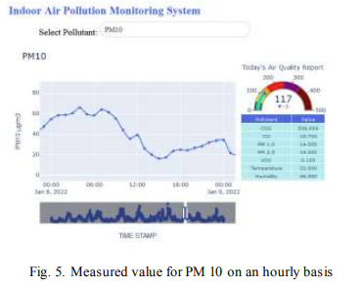
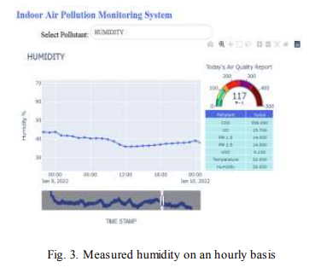
Measured values of different pollutants on an hourly and daily basis.
[4, Fig 3]
[4, Fig 8]
[4, Fig 4]
[4, Fig 3]
[4, Fig 7]
[4, Fig 5]

Slide 24
Paper #3 Smart City Battery Operated IoT Based Indoor Air Quality Monitoring System

Slide 25
Battery-Operated, Portable IoT IAQ System
Low-cost, 30-hour battery life, featuring multiple sensors.
USB cable power option with simultaneous battery charging.
Tested in various environments like kitchens and computer labs.

Slide 26
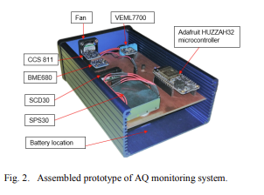
Design and Development
The system is designed to be low-cost, portable, and IoT-enabled.
A sensor array, a microcontroller board with Wi-Fi capability, and a custom smartphone app.
A fan for air flow and a housing to enclose the components of the system
[5, Fig 2]

Slide 27
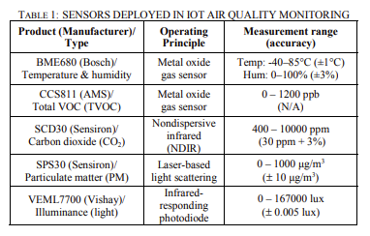
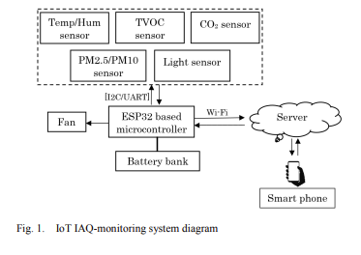
Microcontroller and Sensor Integration
The sensors are selected based on their operating principles, measurement ranges, and accuracy
[5, Fig 1]
[5, Tab 1]

Slide 28
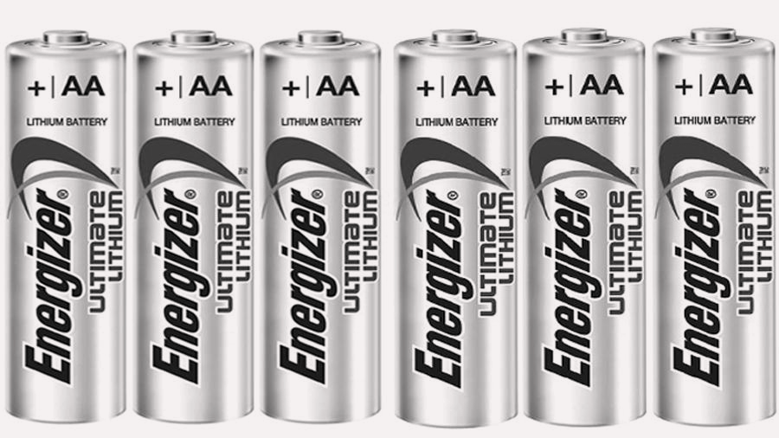
Power Source
Powered by 6 × L91 Energizer lithium batteries with a capacity of around 3000 mAh.
Under real-time logging conditions, has a battery life of approximately 30 hours.
Battery life can be extended by adjusting the sampling time or using a USB cable

Slide 29
Testing Cases
Test 1
Test 2
Environment : Computer Laboratories in University of Warwick
Cooking environment for one hour duration
Results: Both Co2 and VOC levels were elevated.

Slide 30
03
System Architecture

Slide 31
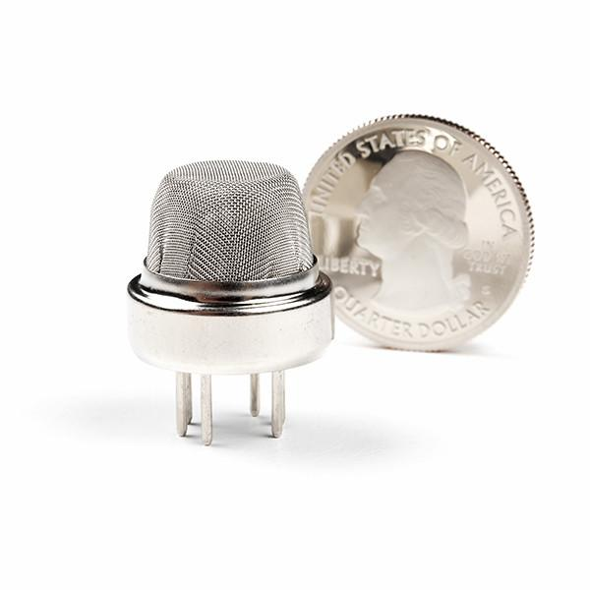
Steps taken to build the Architecture of IoT System
Step 1: IoT Architecture and System Design
Step 2: Hardware Implementation
Step 3: Software Components
Step 4: Calibration Sensors
Application -> Network -> Perception Layer
ESP32, gas and temperature sensors
Arduino Cloud & IFTTT
Establish baseline readings of sensors

Slide 32
Step 1: IoT Architecture and System Design
Multi-tier architecture: sensors, microcontroller, cloud-based platform.
Three-layered IoT model: perception, transport, processing, application layers.
Application Layer | Arduino Cloud real time monitoring Dashboard
Network Layer | Between the communication and sensing layer using Wi-Fi.
Perception Layer/ Sensing Layer | Sensing the physical parameters via MQ-2, MQ-9 , MQ-135 and DHT11 sensors
Fig. 1 Four-layered IoT Architecture for IAQ Monitoring System

Slide 33
Step 1: IoT Architecture and System Design
Layers of Architecture:
Application Layer: Arduino Cloud for real-time monitoring dashboard.
Network Layer: Communication between sensing and transport layers via Wi-Fi.
Perception/Sensing Layer: Utilizing MQ-2, MQ-9, MQ-135, and DHT11 sensors.

Slide 34
Step 2: Hardware Implementation: Microcontroller
Initial use of ESP8266 microcontroller, limited by insufficient ports.
Switched to ESP32 microcontroller for more GPIO ports and high processing power.
Sensor array: MQ-2 (smoke, flammable gases), MQ-9 (LPG, CO, CH4), MQ-135 (CO, CO2, NH3, SO2, benzene), and DHT11 (temperature, humidity).

Slide 35
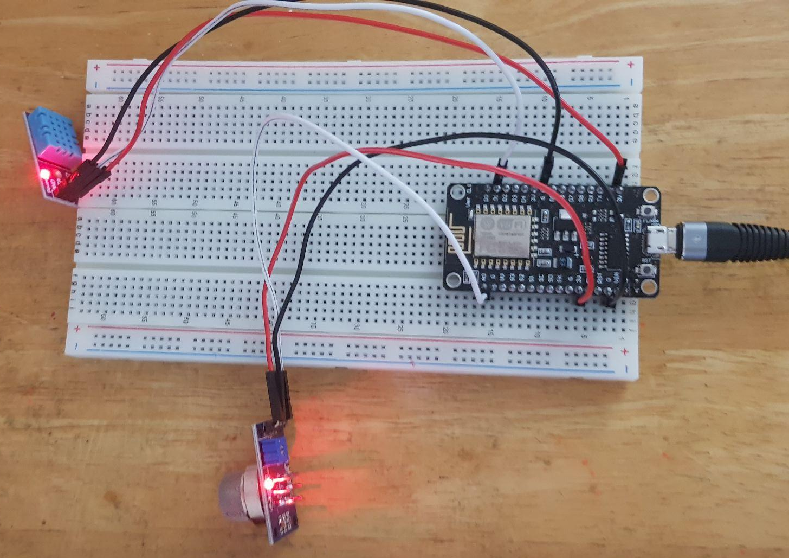
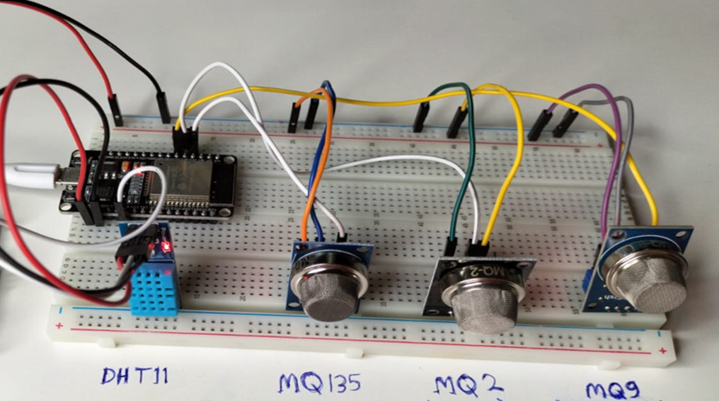
Step 2: Hardware Implementation:
Fig. 2 Hardware Setup of ESP8266 with MQ-2 and DHT11 Sensors
Fig. 3 Hardware Setup Illustrating the ESP32 with the four sensors

Slide 36
Step 2: Hardware Implementation: Sensors
To detect a broad range of pollutants
MQ-2
MQ-9
MQ-135
DHT11: Temperature and Gas sensor

Slide 37
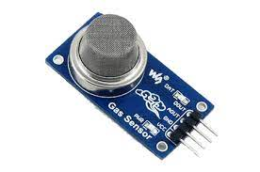
Step 2: Hardware Implementation: MQ-2
High sensitivity to smoke, LPG (Liquefied petroleum gas) and other flammable gases and steam,
Will be used in this project to detect smoke.

Slide 38
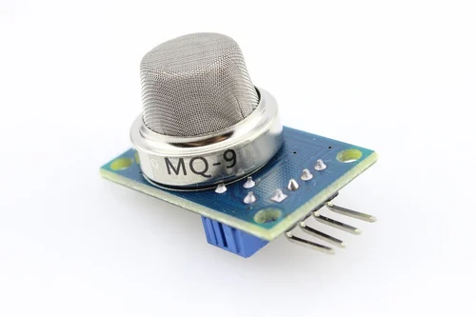
Step 2: Hardware Implementation: MQ-9
Capable of detecting potential gas leakage, liquefied petroleum gas (LPG), carbon monoxide (CO), methane (CH4), as it has high sensitivity to LPG
Sensor will be used for detecting LPG indoors

Slide 39
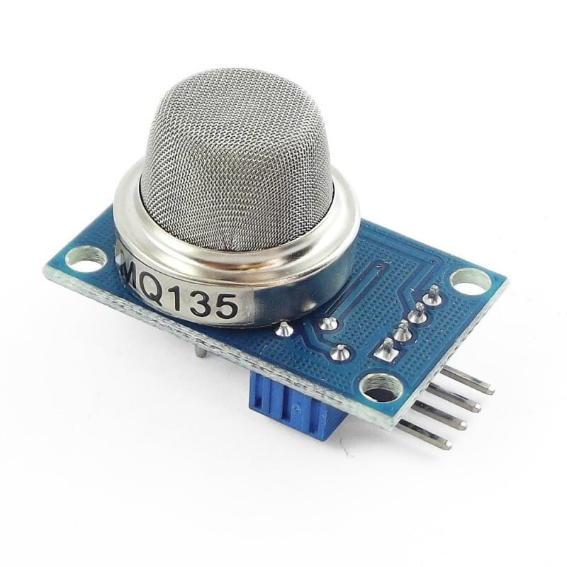
Step 2: Hardware Implementation: MQ-135
Used to detect carbon monoxide (CO), carbon dioxide (CO2), ammonia (NH3), sulfur dioxide (SO2) and benzene
Will be used for sensing alcohol and acetone in this project

Slide 40
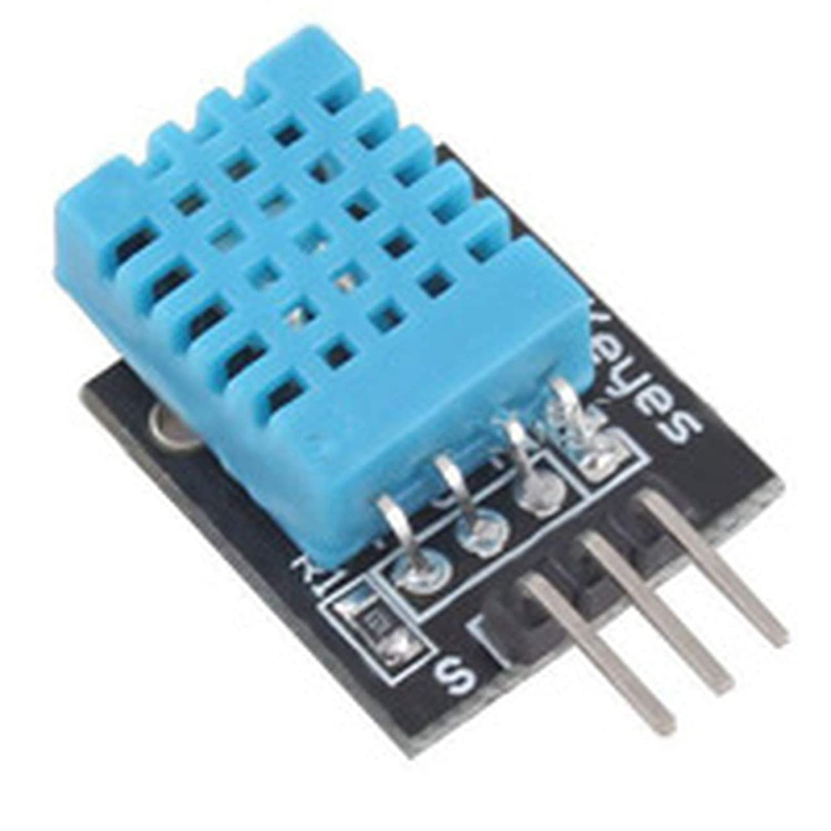
Step 2: Hardware Implementation: DHT11
Used for measuring temperature and humidity
provides essential readings to understand the environmental conditions influencing the IAQ

Slide 41
Sensor | High Sensitivity
MQ-135 | Alcohol. Acetone
MQ-2 | Smoke, liquified natural gas, propane
MQ-9 | LPG, Gas leakage detection, CO
Table 2 High sensitivity for each gas sensor

Slide 42
Step 3: Software Components
Use of Arduino IDE for coding, compiling, and uploading to microcontroller.
The variables are defined for each sensor with the specific pin numbers on the microcontroller.
Connection to Arduino Cloud for communication.
IFTTT for automating data collection and storage in Google Sheets.

Slide 43
Step 4: Calibration of Sensors
Critical step in the methodology,
setting the baseline readings in a controlled environment.
Sensors were left in a neutral environment for 12 hours to establish a baseline reading.
After the 12 hours is complete, the sensors were exposed to different chemicals to trigger the sensors and show higher readings and ensure the sensors revert back to the baseline setting.

Slide 44
Step 4: Establish the Threshold
Establishing a threshold in gas sensors is setting a specific point at which the sensor will trigger an alert or action when it detects gas concentrations above that level.
To establish the threshold, each sensor was exposed to substances that it was highly sensitive to and alert the sensors to the highest point of exposure.
Smoke for MQ-2, alcohol for MQ-135, and butane for MQ-9.

Slide 45
04
Implementation

Slide 46
Implementation Phases
Hardware Setup
Software Implementation
Data Collection and Real-time Monitoring
Microcontroller & Sensors
Arduino IDE
Arduino Cloud & IFTTT

Slide 47
Hardware Setup
The core of the hardware is the ESP32 microcontroller
high processing capability and multiple GPIO ports.
Sensors include the MQ-2, MQ-9, and MQ-135 along with the DHT11 sensor. Each sensor's output is linked to specific pins on the microcontroller for data transmission.

Slide 48
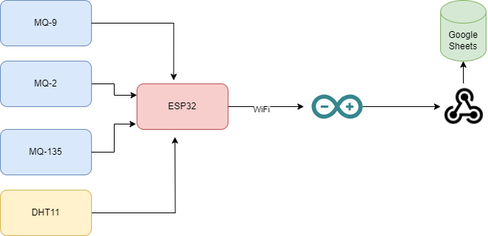
Fig. 4 Block diagram of the IoT system

Slide 49
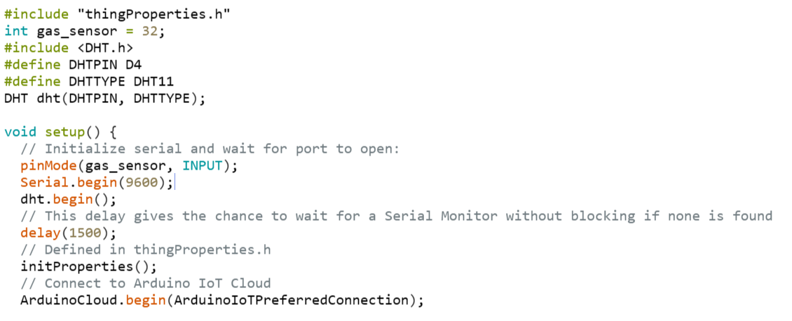
Software Implementation : Arduino IDE Libraries
Arduino IDE is used to program and configure the microcontrollers
Libraries used
“DHT11.h” and “DHTesp.h'' for the DHT11 sensors,
“MQUnifiedSensor.h” for interfacing with the MQ series gas sensors.
‘thingroperties.h’ library is required for managing the variables in the Arduino Cloud

Slide 50
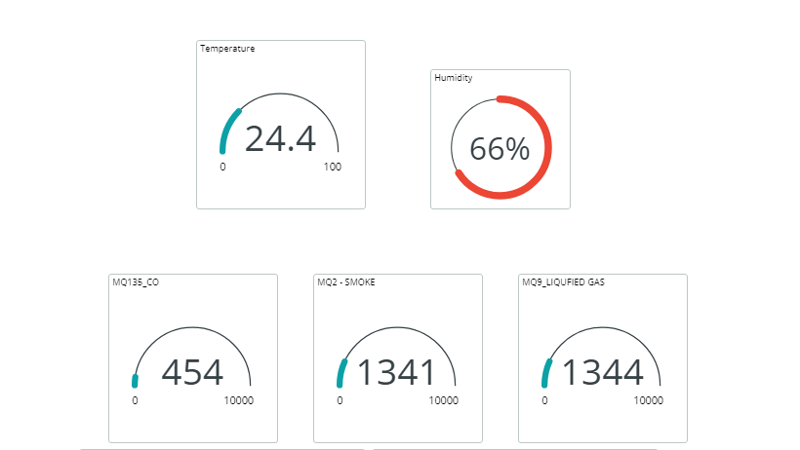
Software Implementation: Arduino Cloud
The ‘thingroperties.h’ library is required for managing the variables in the Arduino Cloud and allowing users to view the sensors via the dashboard from gauges or graphs.
Fig.4 Arduino Cloud Real-time Monitoring Dashboard

Slide 51
Data Collection and Real-time Monitoring
IFTTT applets connect Arduino Cloud to Google Sheets for data collection.
Real-time monitoring available on Arduino Cloud dashboard.
Dashboard shows immediate sensor responses to specific chemical exposures.
Fig.4 Arduino Cloud Real-time Monitoring Dashboard

Slide 52
05
Testing Sensors
Background Information about the topic

Slide 53
Testing
To ensure the data readings are accurate and the sensors are reacting to the environment properly, various testing cases were conducted.

Slide 54
Step 4: Sensor Readings Against Different Testing Subject
Pollutant | Sensors
 | MQ-2 | MQ-9 | MQ-9
Butane | 4095 | 4095 | 1234
Vape Smoke | 1383 | 1500 | 170
Incense Smoke | 1776 | 2065 | 169
Insect Repellent Spray | 2441 | 1473 | 4095
Alcohol | 3319 | 4095 | 4095
Fire | 2533 | 1917 | 300
Table 3 Sensor Readings Against Different Testing Subjects

Slide 55
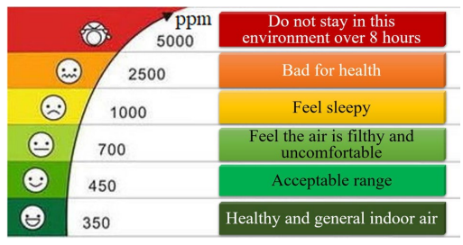
IAQ Index
Fig. 5 IAQ Index for CO2 concentrations and the effects on the human body [12]

Slide 56
Test Cases

Slide 57
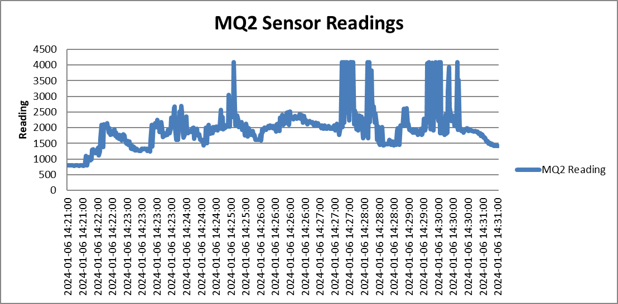
Test Case #1: MQ-2 Smoke Sensor Testing
Exposure to large amounts of smoke to trigger sensor threshold.
Fig. 6 MQ-2 sensor detecting smoke

Slide 58
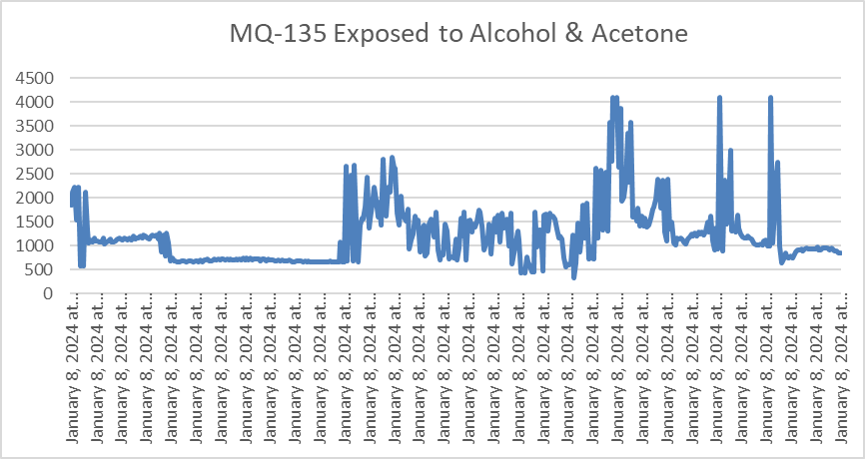
Test Case #2: MQ-135 Alcohol & Acetone
Sensor tested for its response to alcohol and acetone.
Fig. 7 MQ-135 sensor detecting alcohol & acetone

Slide 59
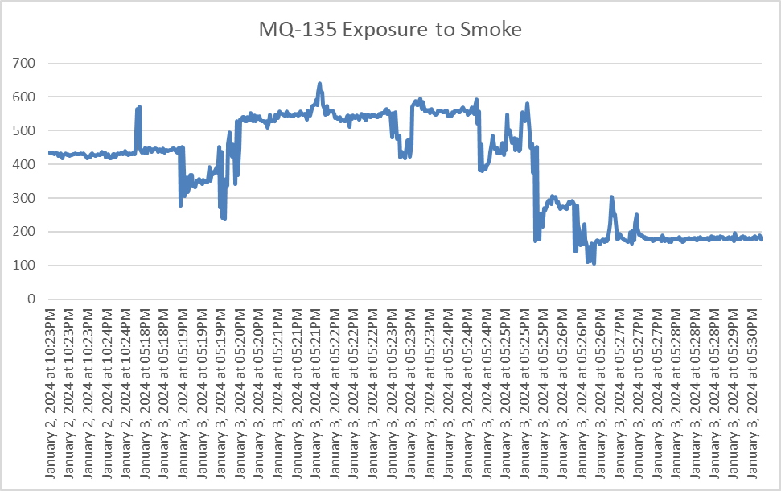
Test Case #3: MQ-135 Exposure to Smoke
Testing to confirm MQ-135 does not react to smoke (baseline readings indicate healthy environment).
Fig. 8 MQ-135 sensor detecting smoke

Slide 60
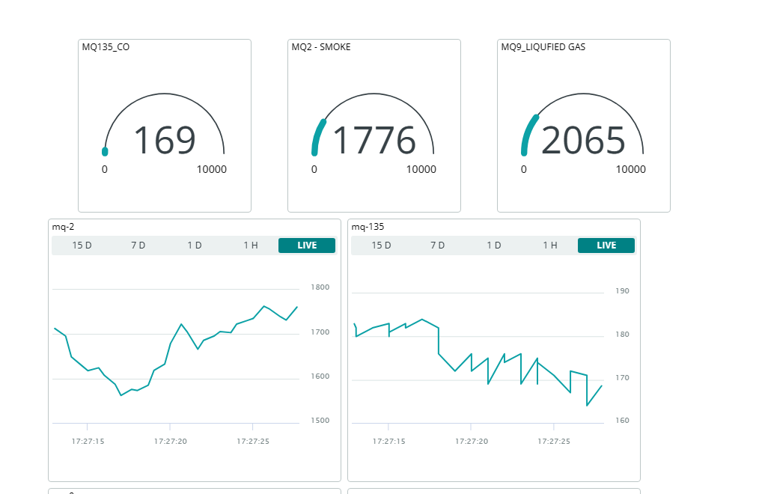
Test Case #3: MQ-135 Exposure to Smoke
Testing to confirm MQ-135 does not react to smoke (baseline readings indicate healthy environment).
Fig. 9 MQ-135 sensor readings shown in Arduino Cloud

Slide 61
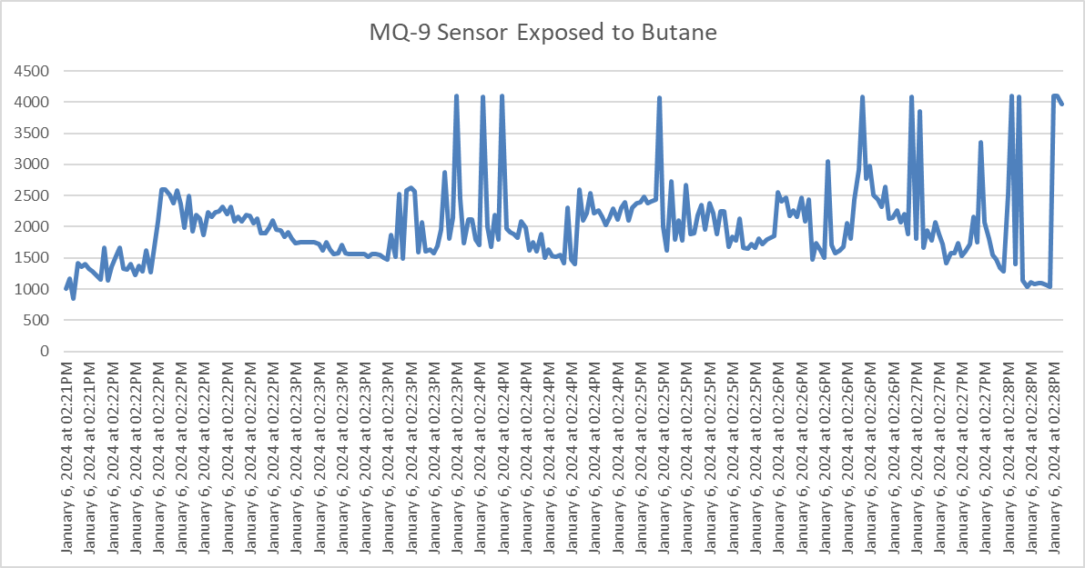
Test Case #4: MQ-9 Liquefied Gas (Butane) Exposure
Sensor exposed to butane to test responsiveness.
Fig. 10 MQ-9 sensor readings liquified gas

Slide 62
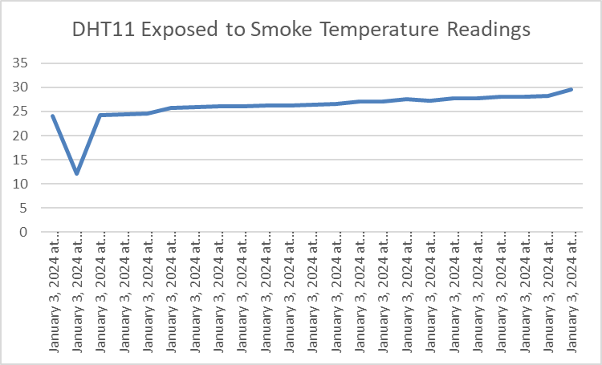
Test Case #5: Temperature and Humidity Sensor Exposure to Smoke
Fig. 11 DHT11 Temperature Readings

Slide 63
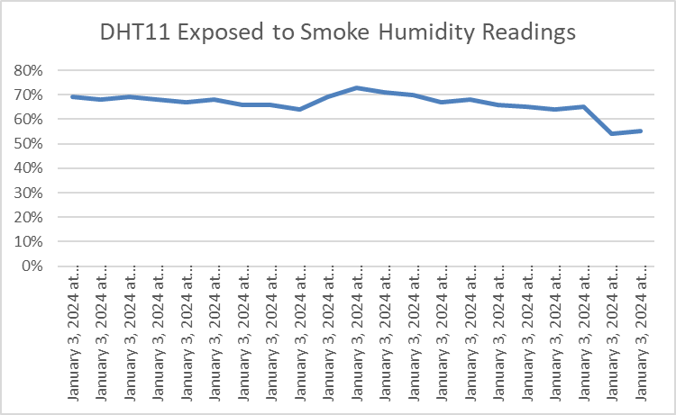
Test Case #5: Temperature and Humidity Sensor Exposure to Smoke
Fig. 12 DHT11 Humidity Readings

Slide 64
06
Time Series Forecasting Algorithm

Slide 65
Time Series Forecasting Algorithm
Time series forecasting is a method used to predict future values based on previously observed values in time-ordered data
Used commonly in
Stock prices, weather forecasting, etc

Slide 66
Time Series Forecasting Algorithm
The primary goal of this algorithm is to predict future sensor readings (from an MQ-135 sensor) using historical data.
The MQ-135 sensor is typically used for air quality monitoring, so accurate predictions can be vital for environmental analysis, public health, or industrial safety.
RMSE (root mean squared error) is used as an error measurement. ensuring the accuracy of the predictions.
The algorithm is flexible, and can be adapted to different types of sensor readings.

Slide 67
Long Short-Term Memory Model (LSTM)
To perform the time series forecasting algorithm, the LTSM model is used to learn from the sequences of the data.
This model is a type of recurrent neural network that is best suited for time series forecasting as it
has the ability of remembering previous data inputs for a longer period of time.

Slide 68
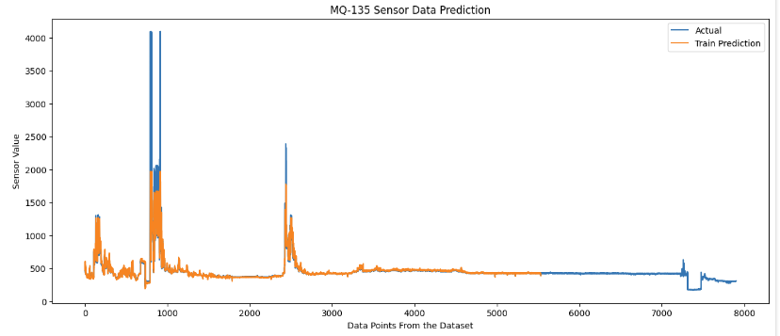
Fig. 13 Results of the forecasting and the actual data readings

Slide 69
Dataset Used
MQ-135 sensor reading, collected over a period of four days

Slide 70
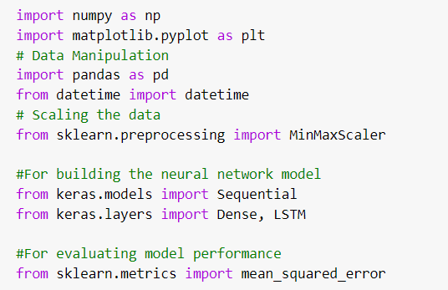
Step 1:Importing Libraries
Numpy: Numerical Operations
Matplotlib: Plotting Graphs
Pandas: Data manipulation and analysis
Datetime: handling the date and time of the data
MinMaxScaler: Normalizing Data
Sequential: To create a linear stack of layers for the neural network
Dense, LSTM : Create LSTM and dense layers in the neural network
Mean_squared error: compute the mean squared error to identify overfitting and accuracy

Slide 71
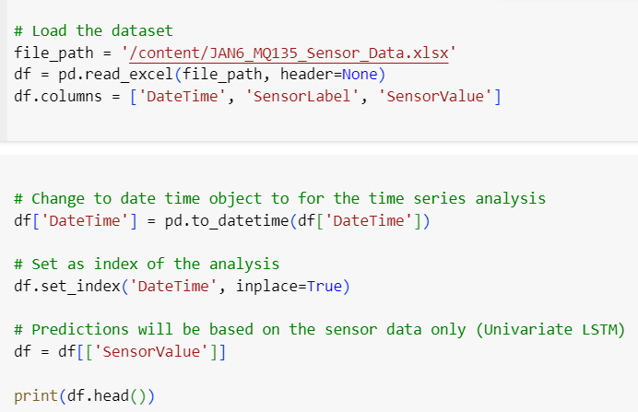
Step 2: Data Loading and Preparation
Load Dataset into a pandas dataframe
Convert date time to datetime object for time series analysis
Set DateTime as index of this univariate algorithm
Keep only SensorValue as the target variable for prediction

Slide 72
Step 3: Data Normalization
Using MinMaxScaler from sklearn.preprocessing
Normalization is a scaling technique in which data values are shifted and rescaled so they end up ranging between 0 and 1.
Avoid higher values overtaking : Without normalization, variables that are measured in higher scales will overtake the smaller scales

Slide 73
Step 4: Train-Test Split
The dataset is split into training and testing sets using a 70%-30% split.

Slide 74
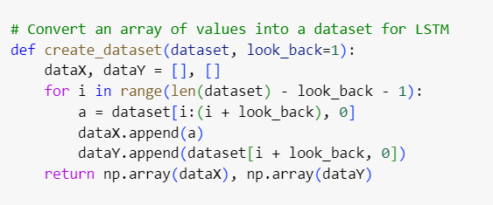
Step 5: Data Preprocessing for LSTM
Create Dataset Function: reshapes the dataset into a format that LSTM requires,
Creating sequences of past observations (look_back) to predict the next value.
Notes:
From the current position i, it takes look_back number of values and appends this sequence to dataX.
It then appends the next value in the dataset (at position i + look_back) to dataY.
This process essentially creates pairs of sequences (dataX) and the next value (dataY)

Slide 75
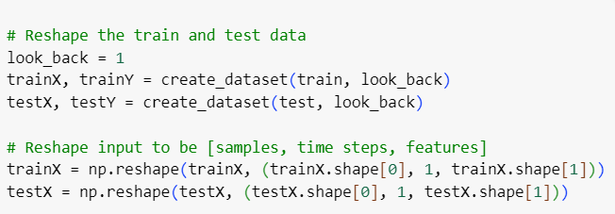
Step 6: Reshape the train and test data
After creating the dataset, the next step is to reshape it into a format suitable for LSTM models.
Features: number of predictors used by the model (1 as we are using only sensor values)
Notes:
Features: The number of predictors used by the model. In this case, it's 1 since you are only using the sensor values.

Slide 76
Step 6: Training the Model
After creating the dataset, the next step is to reshape it into a format suitable for LSTM models.
Features: number of predictors used by the model (1 as we are using only sensor values)

Slide 77
Step 6: Training the Model
Add series of steps that the data will pass through the method
Recall 4 readings at a time
Notes:
model.add(LSTM(4, input_shape=(1, look_back))): Here, we're adding a brain to our robot, specifically a brain that's good at remembering patterns over time. This is what LSTM (Long Short-Term Memory) is good at. The number 4 here means our robot's brain can remember four things at a time. The input_shape=(1, look_back) part is like telling the robot how many past temperature records (days) it should look at to make a prediction.
model.add(Dense(1)): After processing the information with its LSTM brain, the robot makes a prediction about tomorrow's temperature. This step is like saying, "Based on what you remember, tell me what you think the temperature will be."

Slide 78
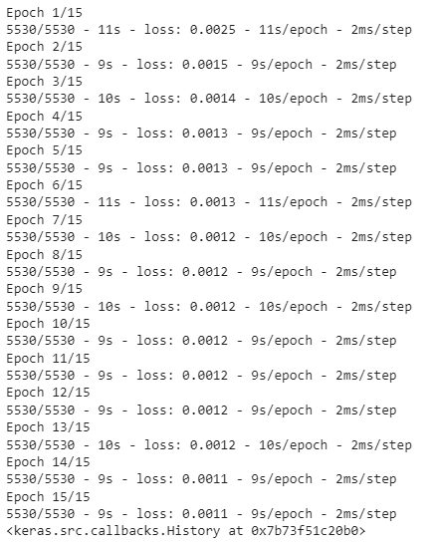
Step 6: Training the Model

Slide 79
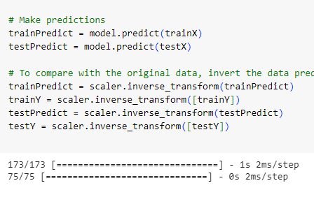
Step 7: Making Predictions
Add series of steps that the data will pass through the method
Recall 4 readings at a time

Slide 80
Step 8: Invert Predictions
Since the was scaled prior to training, we need to inverse the predictions back to the original scale

Slide 81
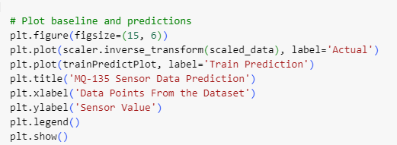
Step 9: Plot Graphs

Slide 82
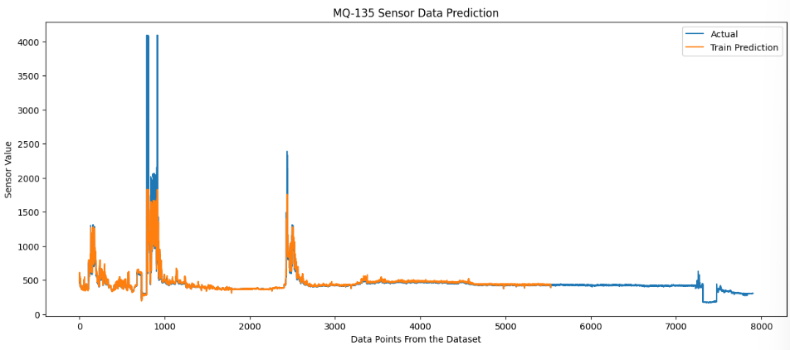
Step 9: Plot Graphs

Slide 83
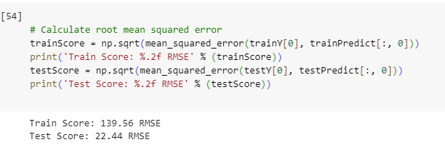
Root Mean Squared Error Result
Results of RMSE
Signs of overfitting as the training score is higher than the test score
Increase Training Data
Current data has random fluctuations and noise
Notes:
Below are the results of the RMSE, these results are not ideal as the training score is significantly higher than the test score. This result shows the overfitting in the data, and in order to avoid that, we need an increased dataset as more data can help the model learn the underlying patterns, with less data there are higher level of features compared to the data points.

Slide 84
RESOURCES
J. Esquiagola, M. Manini, A. Aikawa, L. Yoshioka and M. Zuffo, "Monitoring Indoor Air Quality by using IoT Technology," 2018 IEEE XXV International Conference on Electronics, Electrical Engineering and Computing (INTERCON), Lima, Peru, 2018, pp. 1-4, doi: 10.1109/INTERCON.2018.8526380.
Tran, V. V., Park, D., & Lee, Y. C. (2020). Indoor Air Pollution, Related Human Diseases, and Recent Trends in the Control and Improvement of Indoor Air Quality. International Journal of Environmental Research and Public Health, 17(8), 2927. https://doi.org/10.3390/ijerph17082927
Dhingra, S., Madda, R. B., Gandomi, A. H., Patan, R., & Daneshmand, M. (2019). Internet of things mobile–air pollution monitoring system (IOT-mobair). IEEE Internet of Things Journal, 6(3), 5577–5584. https://doi.org/10.1109/jiot.2019.2903821
Vaheed, Sk., Nayak, P., Rajput, P. S., Snehit, T. U., Kiran, Y. S., & Kumar, L. (2022). Building IOT-Assisted Indoor Air Quality Pollution Monitoring System. 2022 7th International Conference on Communication and Electronics Systems (ICCES). https://doi.org/10.1109/icces54183.2022.9835822
Esfahani, S., Rollins, P., Specht, J. P., Cole, M., & Gardner, J. W. (2020). Smart City Battery operated IOT based Indoor Air Quality Monitoring System. 2020 IEEE SENSORS. https://doi.org/10.1109/sensors47125.2020.9278913
Saini, J., Dutta, M. & Marques, G. A comprehensive review on indoor air quality monitoring systems for enhanced public health. Sustain Environ Res 30, 6 (2020). https://doi.org/10.1186/s42834-020-0047-y

Slide 85
RESOURCES
Cincinelli A, Martellini T. Indoor air quality and health. Int J Environ Res Pu. 2017;14:1286.
Saini, J., Dutta, M. & Marques, G. A comprehensive review on indoor air quality monitoring systems for enhanced public health. Sustain Environ Res 30, 6 (2020). https://doi.org/10.1186/s42834-020-0047-y
Ezzati M, Kammen DM. Quantifying the effects of exposure to indoor air pollution from biomass combustion on acute respiratory infections in developing countries. Environ Health Perspect. 2001;109:481–8.
IEA. World Energy Outlook 2017. Paris: International Energy Agency; 2017.
Ladekar and R. Daruwala, "Indoor Air Quality Monitoring on AWS Using MQTT Protocol", 2019 10th International Conference on Computing Communication and Networking Technologies (ICCCNT), pp. 1-6, 2019.
Sung, W.-T., & Hsiao, S.-J. (2021). Building an indoor air quality monitoring system based on the architecture of the Internet of Things. EURASIP Journal on Wireless Communications and Networking, 2021(1). doi:10.1186/s13638-021-02030-1
A. E. Igwe, A. A. Ezeobi, F. O. Okeke, E. O. Ibem, and E. C. Ezema, "Causes and remedies of sick building syndrome: a systematic review," in Proceedings of the ICECAE 2023, E3S Web of Conferences, vol. 434, p. 02007, 2023. https://doi.org/10.1051/e3sconf/202343402007
Tran, V. V., Park, D., & Lee, Y.-C. (2020). Indoor air pollution, related human diseases, and recent trends in the control and improvement of Indoor Air Quality. International Journal of Environmental Research and Public Health, 17(8), 2927. https://doi.org/10.3390/ijerph17082927

Slide 86
Images Used
"[15] 'Health Effects of Indoor Air Quality on Children and Young People,' Scientific Figure on ResearchGate. [Online]. Available: https://www.researchgate.net/figure/An-overview-of-sources-of-indoor-pollutants-in-a-home_fig2_346443754. [Accessed: Jan. 9, 2024]."

